Slide 1
Social Media Marketing Blitz
Lessons from working with social media analytics to market events and a personality-driven business
Rick Pack

Slide 2
Humans are stimulotropic
Plants are heliotropic (orient to sun)
Humans orient themselves to sources of psychological simulation, such as human touch and attractive images aand sounds
But we (different markets) have different thresholds

Slide 3
Rick Pack and Ryan Pack Impackt Squared Solutions, LLC
Rick is now a Data Scientist with LabCorp involved with a large business analysis and an initiative supporting value-based healthcare (ACOs)
Ryan is now an Account Director wheeler-and-dealer with PPD (CRO: support pharma companies)
Rick was also Vice-President and Chief Marketing Officer for Impackt Squared Solutions, LLC
Ryan was CEO, President and Career Coach for Impackt Squared Solutions, LLC

Slide 4
Rick Pack and Ryan Pack Impackt Squared Solutions, LLC
Impackt Squared Solutions, LLC spent $30k on Facebook ads and many thousands more on various coaches including marketing coaches
The company earned about $15k
Impackt Squared Solutions, LLC caused married couple Rick and Ryan Pack a lot of pain, and the company may soon be dissolved

Slide 5
Rick Pack – rickeyhp@gmail.com
Show my Fbadstats R package (only has FBadGstats function) and invite you to explore $30k of ads performance data
Encourage the perception of online marketing as gambling and addictive to data geeks
Encourage healthy use of social media

Slide 6

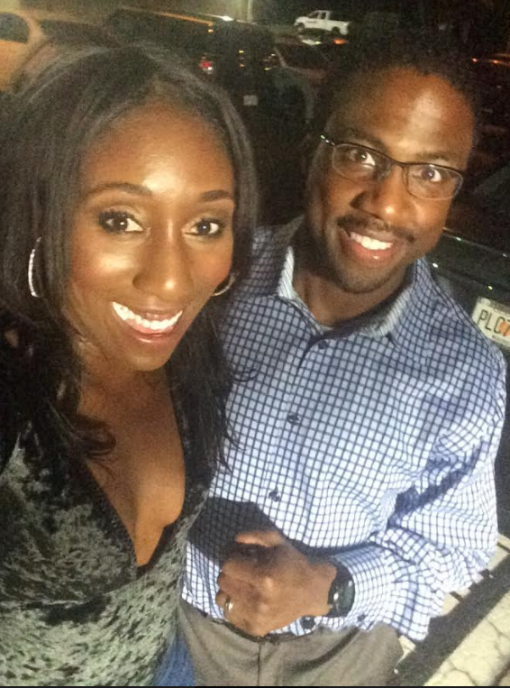
Rick Pack and Ryan Pack Impackt Squared Solutions, LLC

Slide 7

Rick Pack and Ryan Pack Impackt Squared Solutions, LLC
We have volunteered at Junior League of Raleigh,
St. Ambrose Episcopal Church chess mentoring,
Big Brothers, Big Sisters, Boys & Girls Club of Raleigh,
Math ACT tutoring at the Kansas City Urban League

Slide 8
The “magic” Facebook algorithm
Marketing and business coaches often claim algorithm finds buyers.
Any evidence that algorithms reliably find BUYERS, not just responders?
I did not quickly find any and the coaches do not present evidence besides testimonials.
I bought into the hype wholeheartedly.

Slide 9
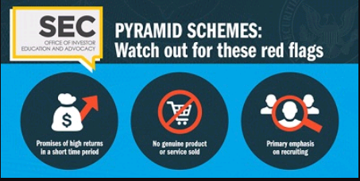
Removed screenshot
A coach’s claim in a webinar:
“most of my clients make back more than their investment
within the first month”

Slide 10
“But even if they're not pyramid schemes, the chances of making any money with multi-level marketing—let alone striking it rich—appear to be remote.”
- “Why Spotting a Pyramid Scheme Isn’t So Easy” by Herb Greenberg and Karina Frayter. CNBC.com

Slide 11
Federal Trade Commission guidance in 16 CFR 255:
Endorsements and testimonials must communicate typical success or clearly indicate they are atypical (my paraphrase).
I am not an attorney and am not providing legal advice.

Slide 12

Vulnerability is healthy

Slide 13
Rick’s package - FBadstats
Many columns in Ads Manager
Many adjustable elements in an advertisement
Many breakdown groups (Designated Market Area, Region, Country)
My package is designed to help analyze and optimize. Maybe it will.

Slide 14
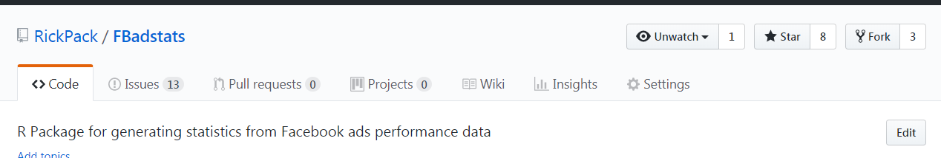
Rick’s package - FBadstats
https://github.com/RickPack/fbadstats

Slide 15
Rick’s package - FBadstats
A use of Ari Lamstein’s choroplethr package – just need region and value columns
statfrm <- FBadGstats('example_Region_AllCols.csv')
## prepare for Ari Lamstein's choroplethr
statfrm$value <- statfrm$LINK.CLICKS
statfrm$region <- statfrm$REGION
mapfrm <- statfrm %>% select(value, region)
statfrm2 <- statfrm %>% group_by(region) %>% summarize(sumspent = sum(AMOUNT.SPENT..USD.), sumclicks=sum(LINK.CLICKS)) %>%
mutate(value = sumspent / sumclicks) %>% distinct(region, value)
statfrm2$region <- tolower(statfrm2$region)
min(statfrm2$value)
min(statfrm2$value, na.rm = TRUE)
statfrm2 <- statfrm2 %>% filter(value > 0 & value < Inf)
state_choropleth(statfrm2, title = 'Cost per click for June, 2017 Impackt Squared Solutions, LLC Facebook ads', legend = 'Cost / Click (US $)')

Slide 16
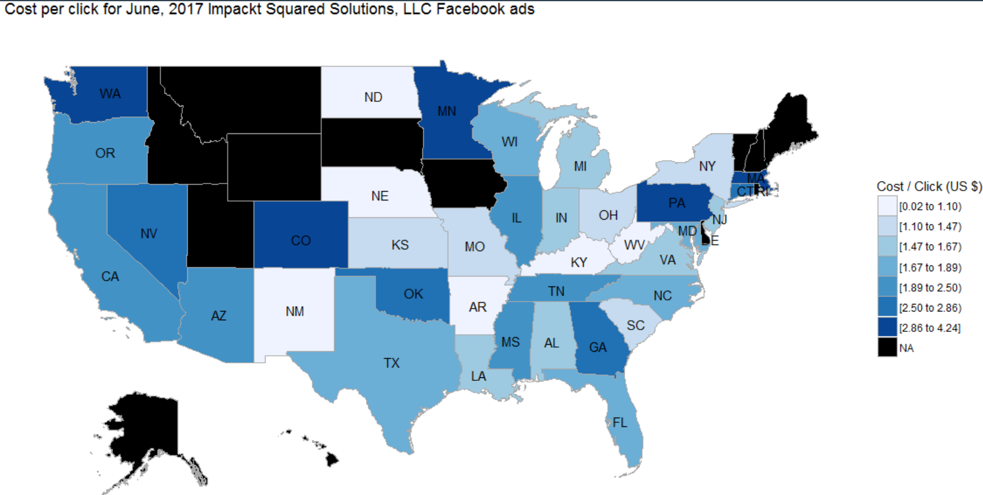
Rick’s package - FBadstats

Slide 17
Rick’s package – Fbadstats Parameter Highlights
filtervar – analyze ads only containing certain text in their names [case-insensitive]
FBadGstats(filerd = "Example_AgeGen_AllCols.csv", filtervar = "Darren")
filtervarneg – exclude ads with certain text [case-insensitive]
FBadGstats(filerd = "Example_AgeGen_AllCols.csv", filtervar = "Darren", filtervarneg = "sub75vid")
sumvar – analyze based on a particular kind of result
FBadGstats(filerd = "Example_AgeGen_AllCols.csv", sumvar = "WEBSITE.LEADS")
See available columns for sumvar by assigning FBadGstats to a data frame and then using colnames()
a <- FBadGstats(filerd = "Example_AgeGen_AllCols.csv", sumvar = "WEBSITE.LEADS")
colnames(a)

Slide 18
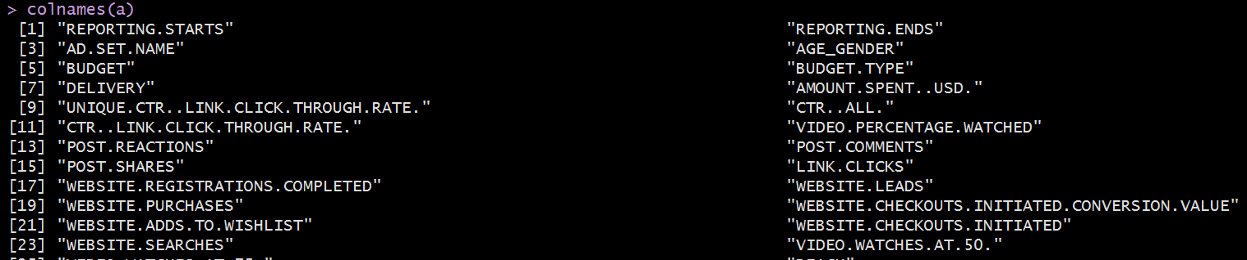
Rick’s package – Fbadstats Parameter Highlights
a <- FBadGstats(filerd = "Example_AgeGen_AllCols.csv", sumvar = "WEBSITE.LEADS")
colnames(a)

Slide 19
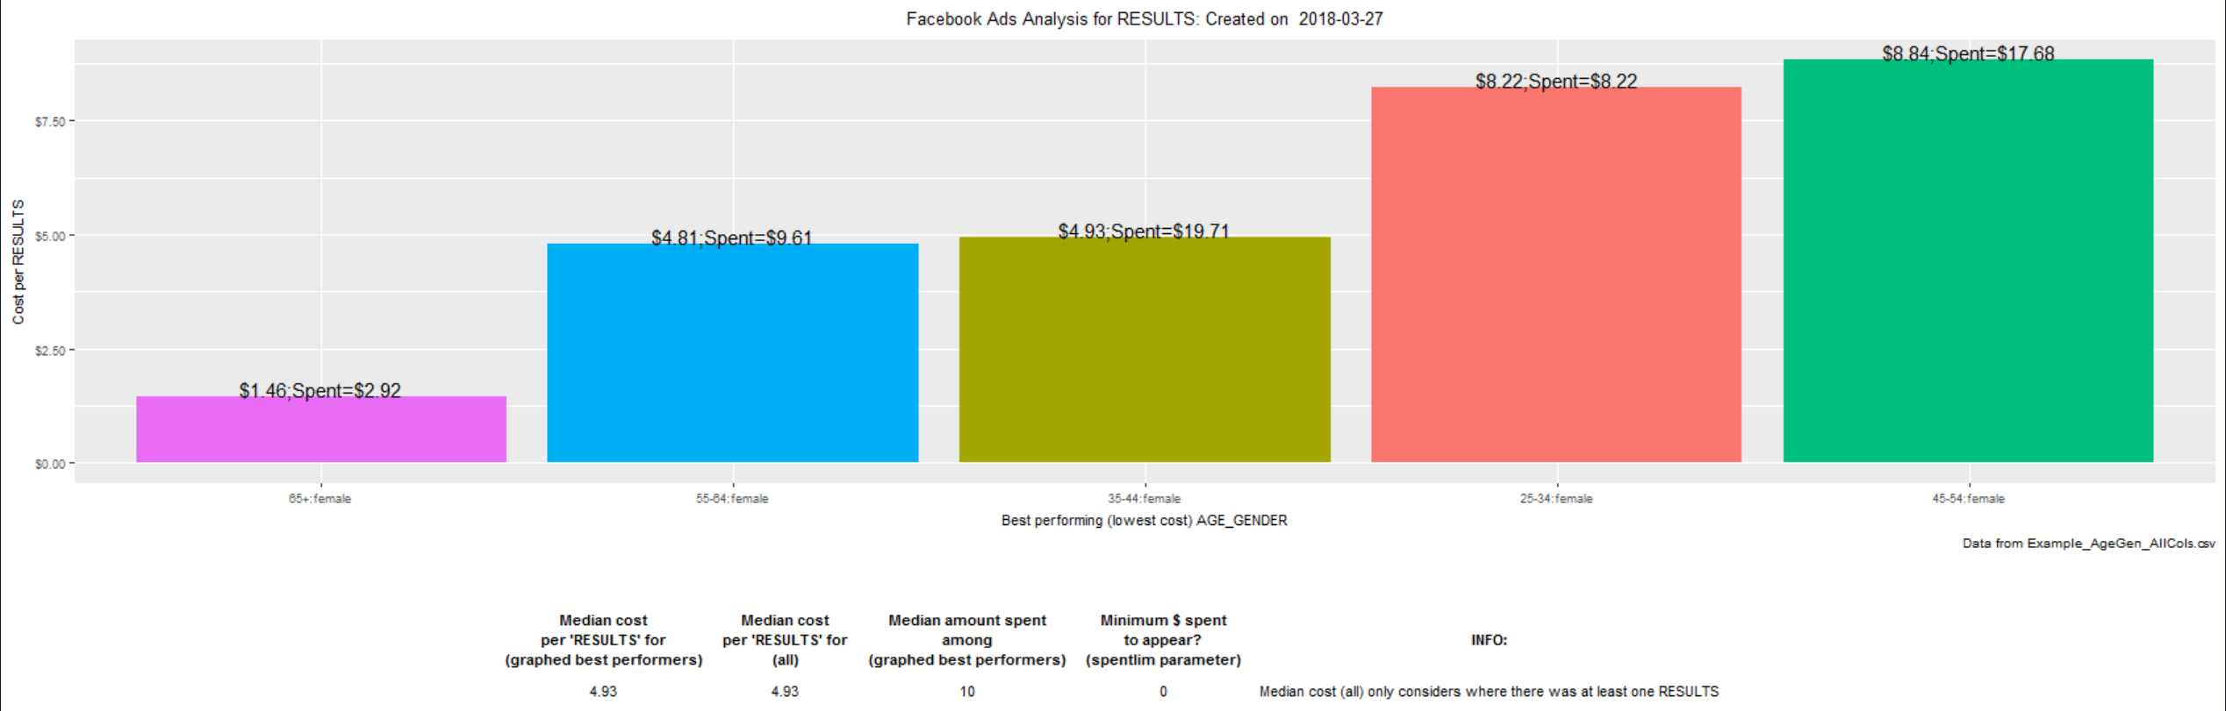
Rick’s package – Fbadstats Parameter Highlights
FBadGstats(filerd = "Example_AgeGen_AllCols.csv", filtervar = "Darren")

Slide 20
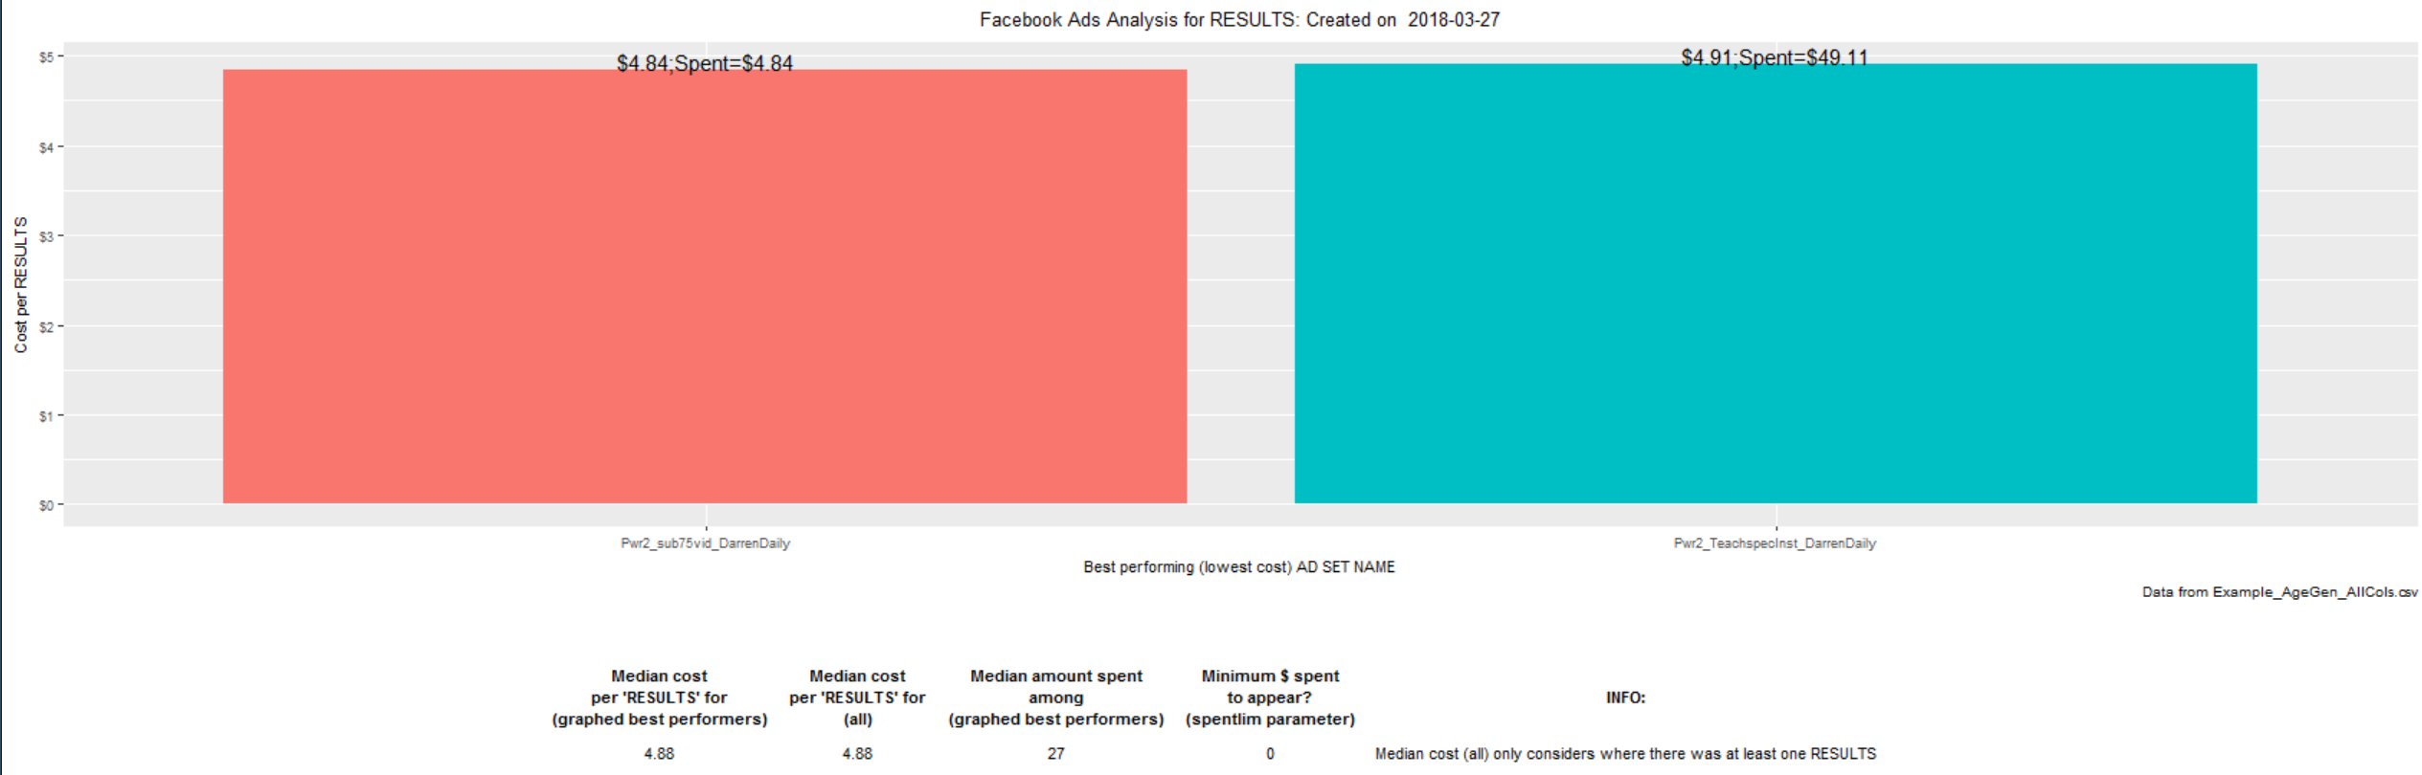
Rick’s package – Fbadstats Parameter Highlights
FBadGstats(filerd = "Example_AgeGen_AllCols.csv", filtervar = "Darren")

Slide 21
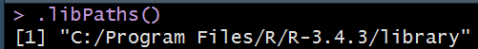
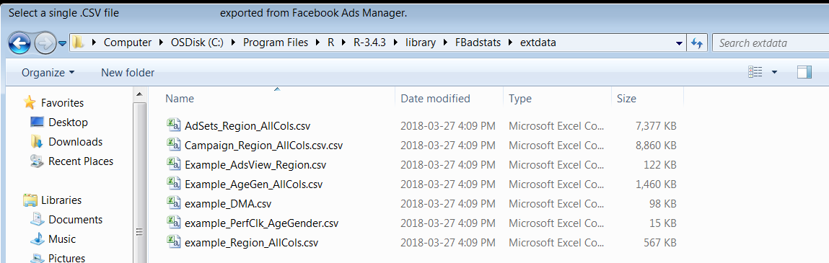
Rick’s package – Fbadstats Parameter Highlights
No filerd parameter: Choose a file to analyze
FBadGstats() [to avoid 0-result distortion]
CSV files without “example” are lifetime ads, otherwise ads run in March, 2017 (31-days)
Default “RESULTS” can cause absurdly cheap summaries so use sumvar
FBadGstats(sumvar = "Link.Clicks")

Slide 22
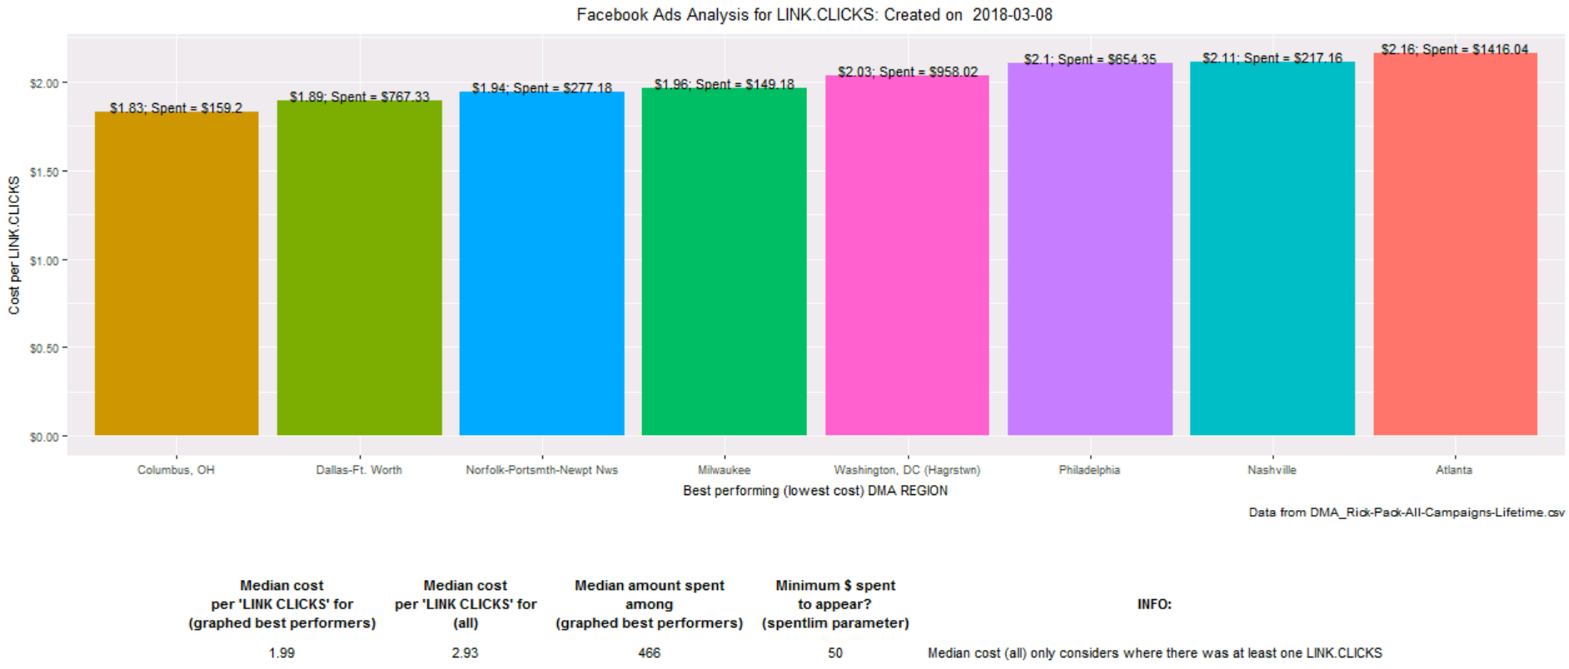
Rick’s package – Fbadstats Parameter Highlights

Slide 23
Marketing Failures
GOAL:
Responders purchase online program (“Power Moves”) or coaching
Targeting smaller cities like Columbus, OH and Norfolk, VA
Excluding Atlanta (may have been a good idea)
Limiting target area to Raleigh-Durham (Fayettevlle) DMA
30-day money-back guarantee

Slide 24
Marketing Successes
GOAL:
Targeting a large group of DMAs
Long ad texts with personal appeals to sensitive needs (social group belonging, feelings of inadequacy, need for hope about wealth potential)
Carousel ads (multiple images)
People liked but not prepared to pay.

Slide 25
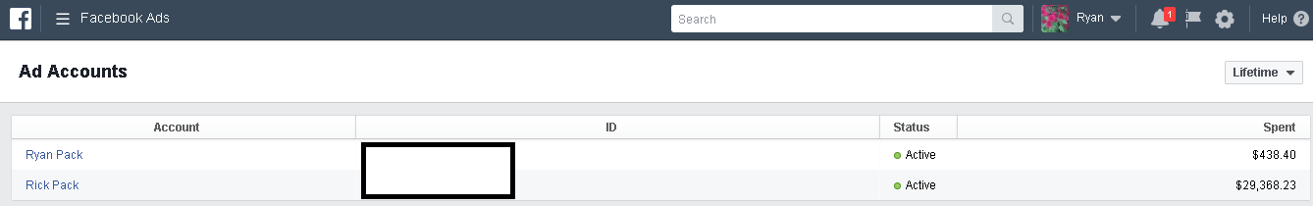
Facebook Ads Manager
Ryan has spent $438.40 and Rick has spent $29,368.23.

Slide 26
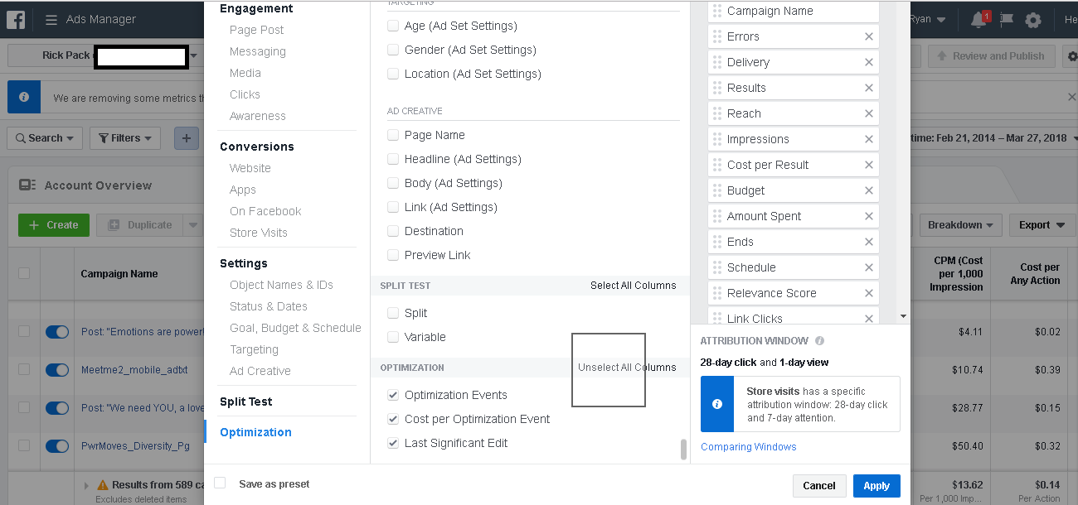
Facebook Ads Manager

Slide 27
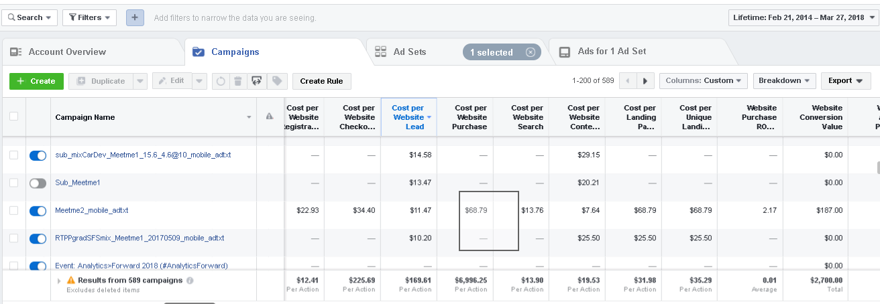
Facebook Ads Manager

Slide 28
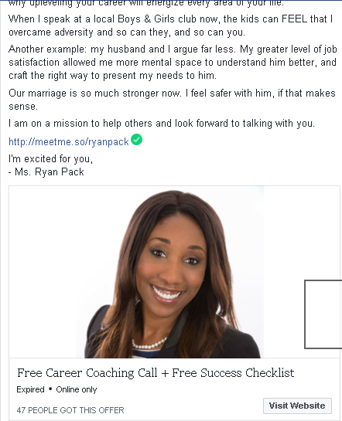
Facebook Ads Manager

Slide 29
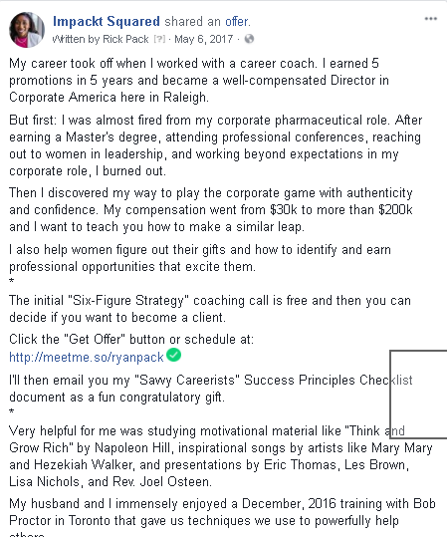
Facebook Ads Manager

Slide 30
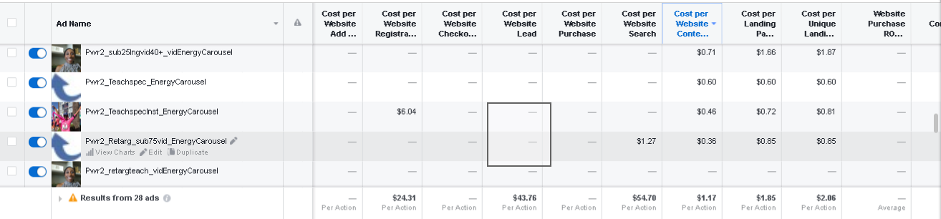
Facebook Ads Manager

Slide 31
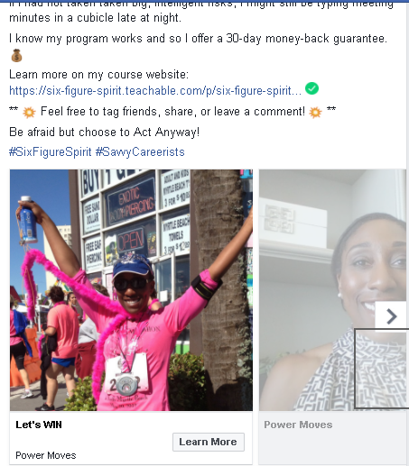
Facebook Ads Manager

Slide 32
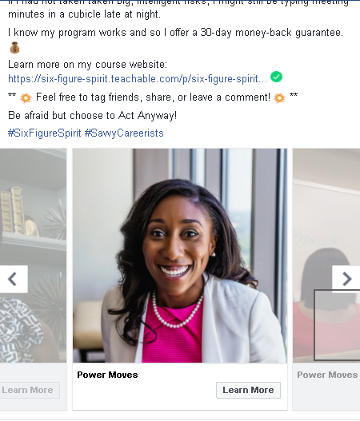
Facebook Ads Manager

Slide 33
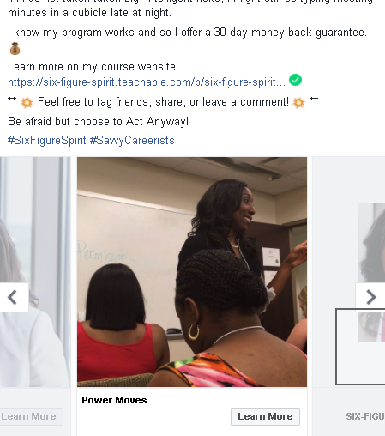
Facebook Ads Manager

Slide 34
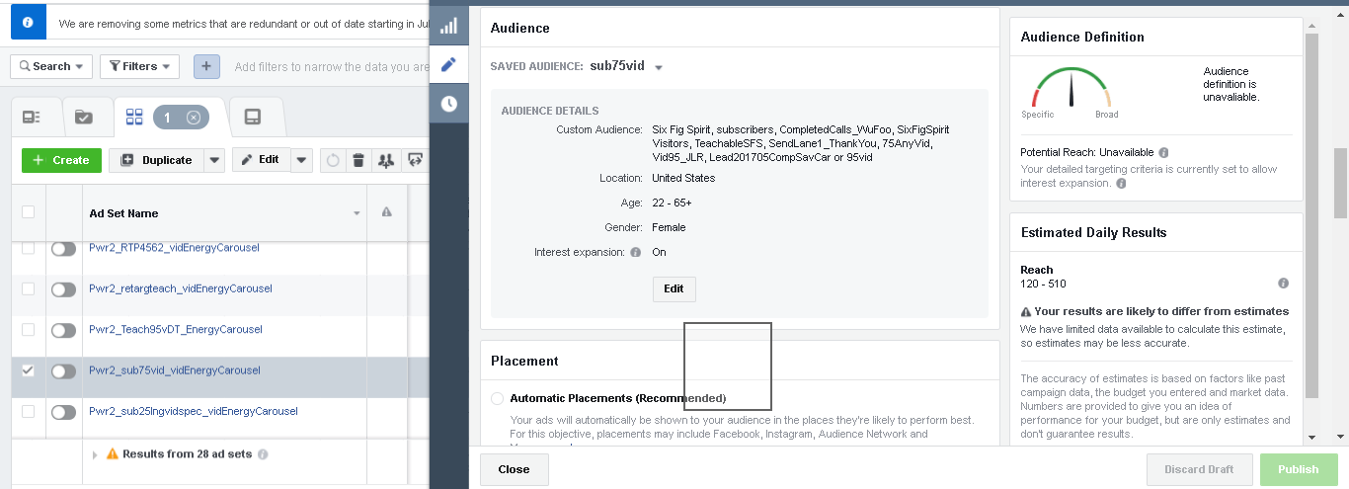
Facebook Ads Manager

Slide 35
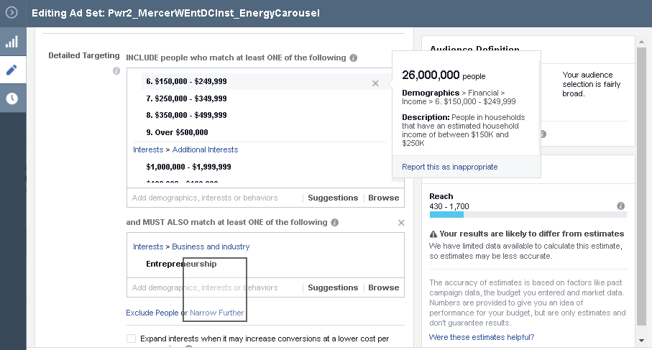
Facebook Ads Manager

Slide 36
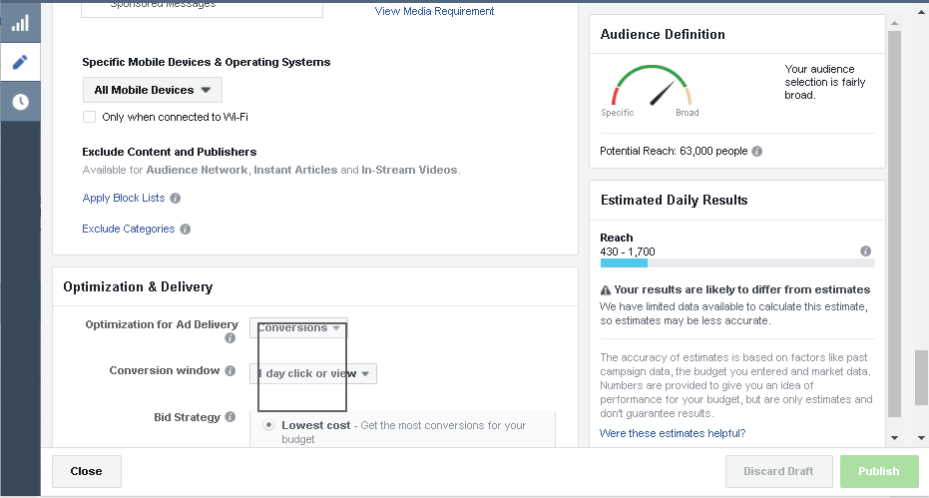
Facebook Ads Manager

Slide 37
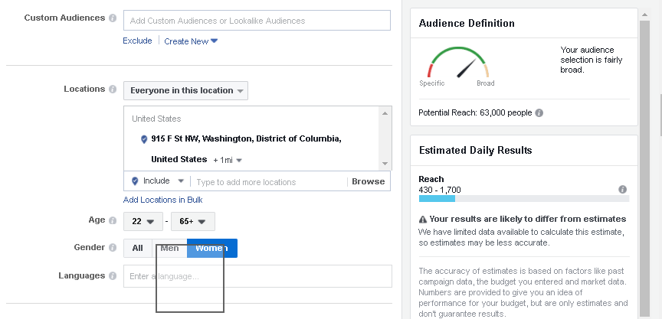
Facebook Ads Manager

Slide 38
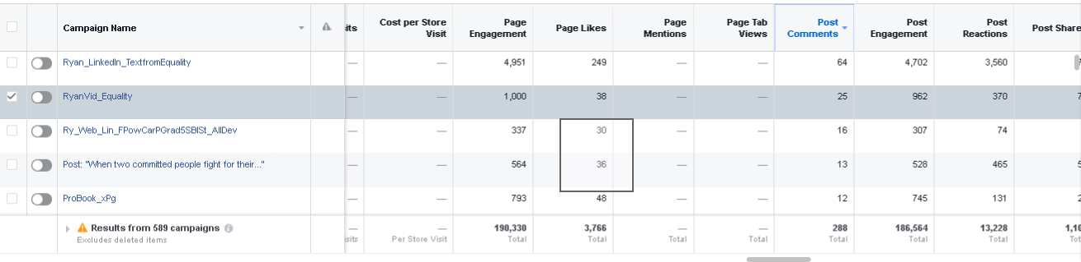
Facebook Ads Manager

Slide 39
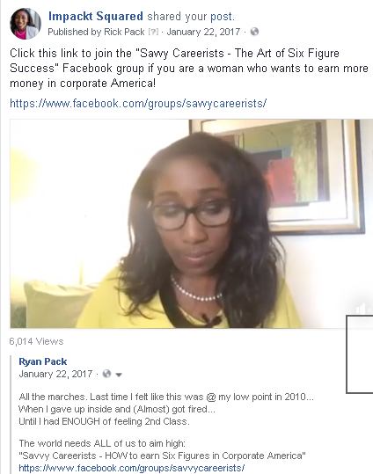
Facebook Ads Manager

Slide 40
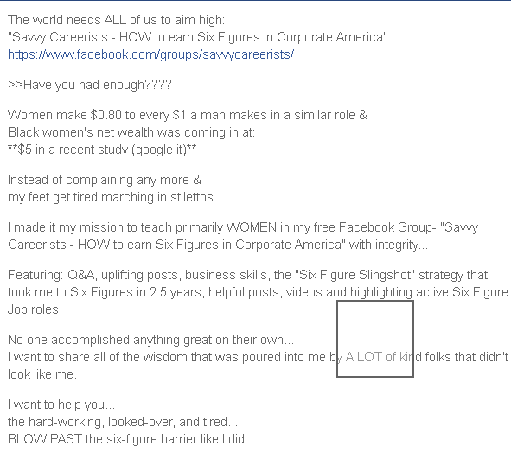
Facebook Ads Manager

Slide 41
Facebook Ads Manager
REMOVED SCREENSHOT

Slide 42
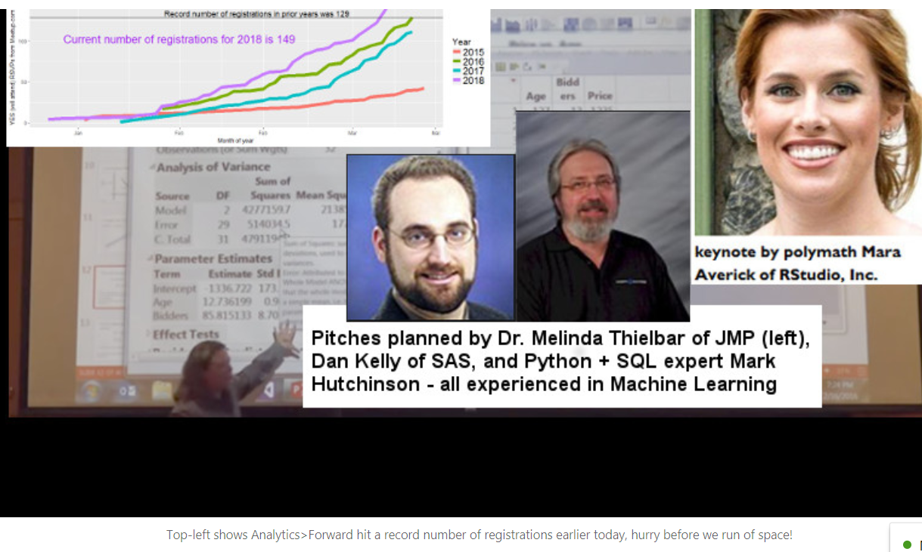
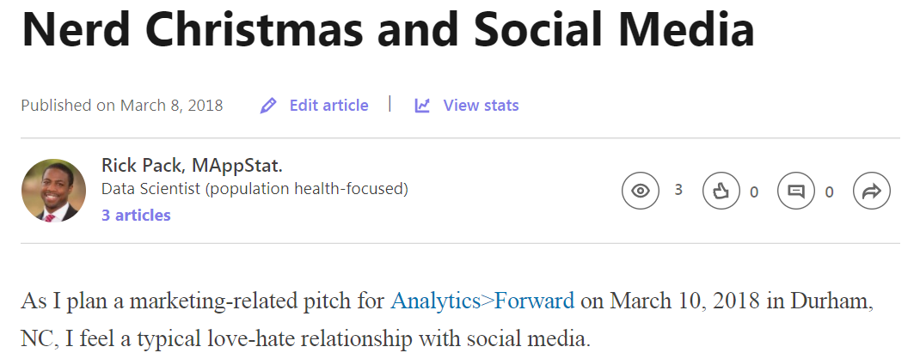
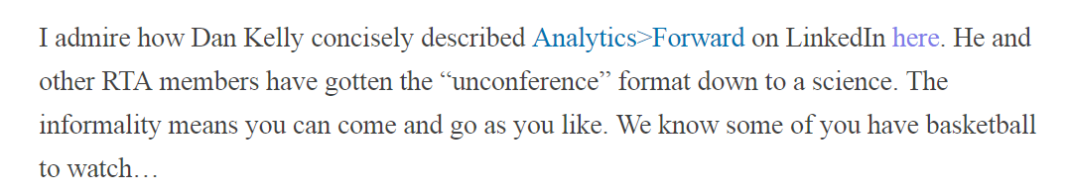

Slide 43
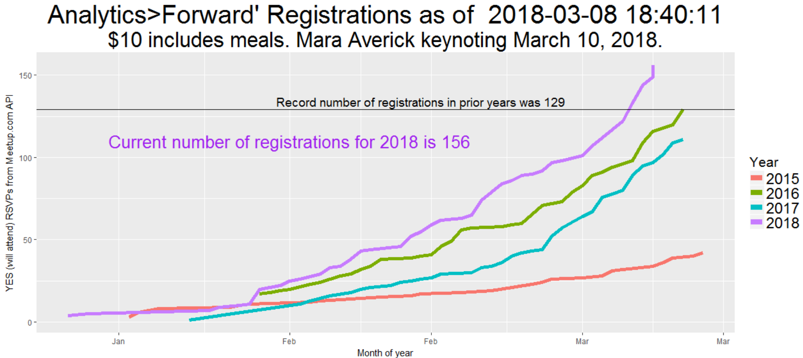

Slide 44
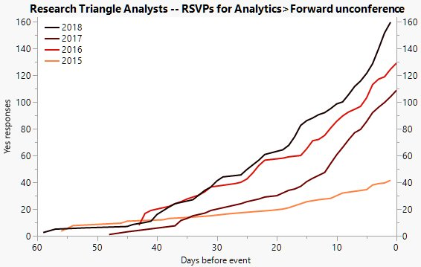
Xan Gregg – March 9th enhancement using JMP

Slide 45
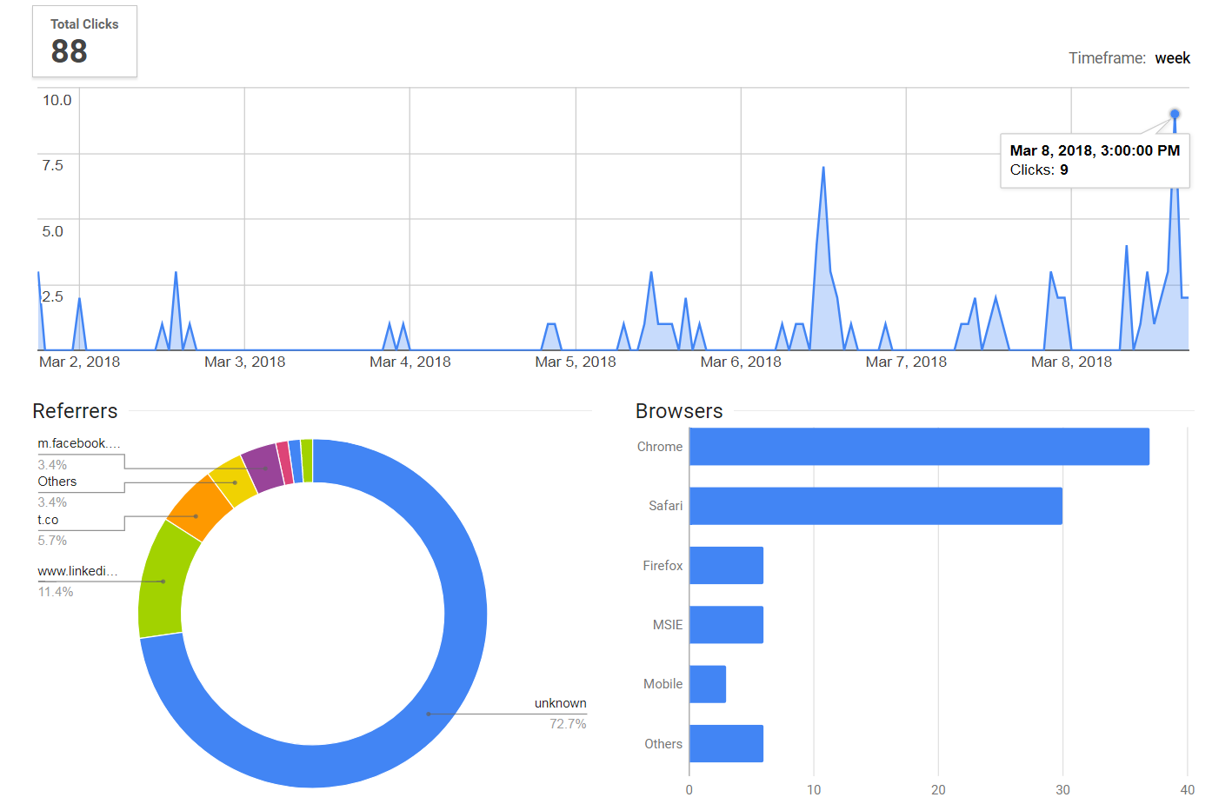
Analytics Forward – Twitter, Facebook, LinkedIn link

Slide 46
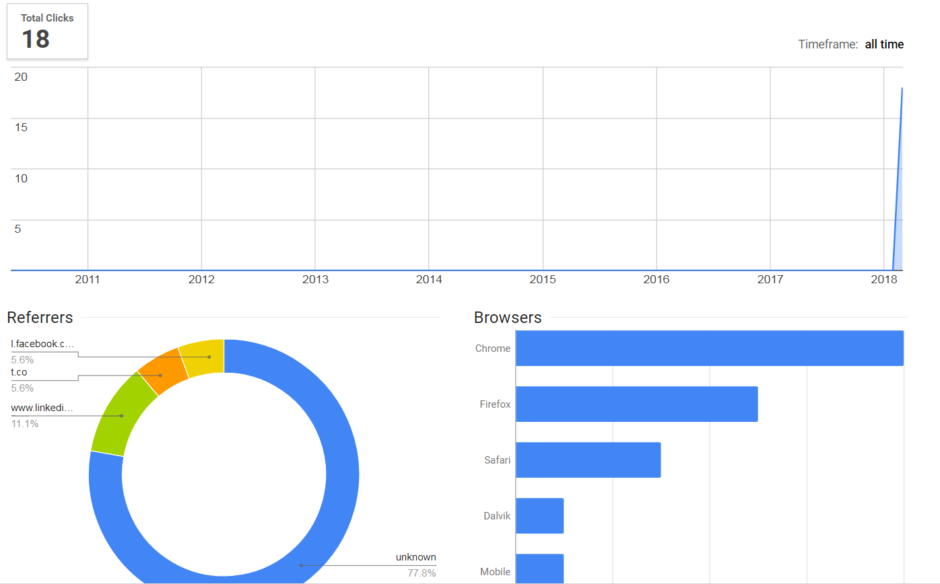
Today’s TriPASS event – Twitter, Facebook, LinkedIn link

Slide 47
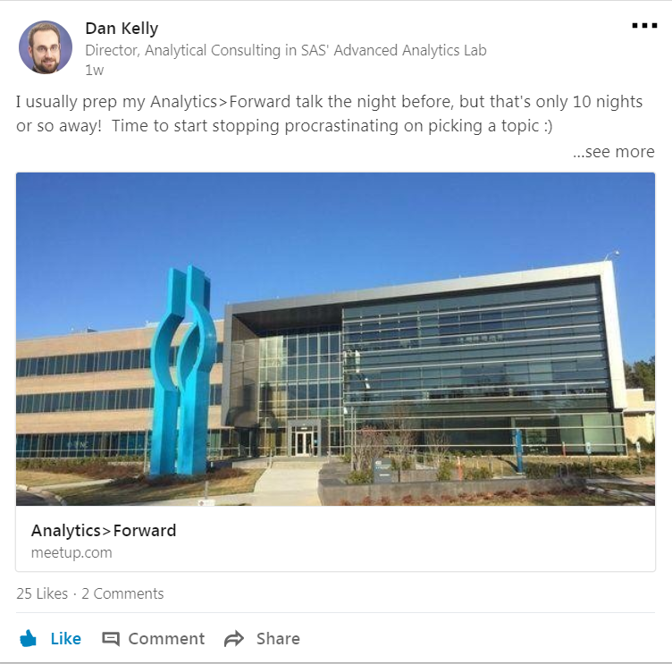

Slide 48
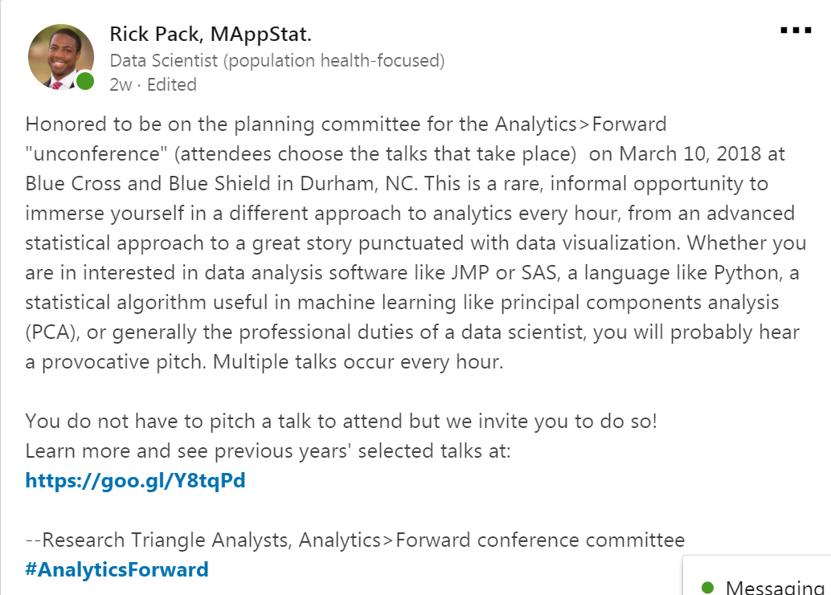

Slide 49
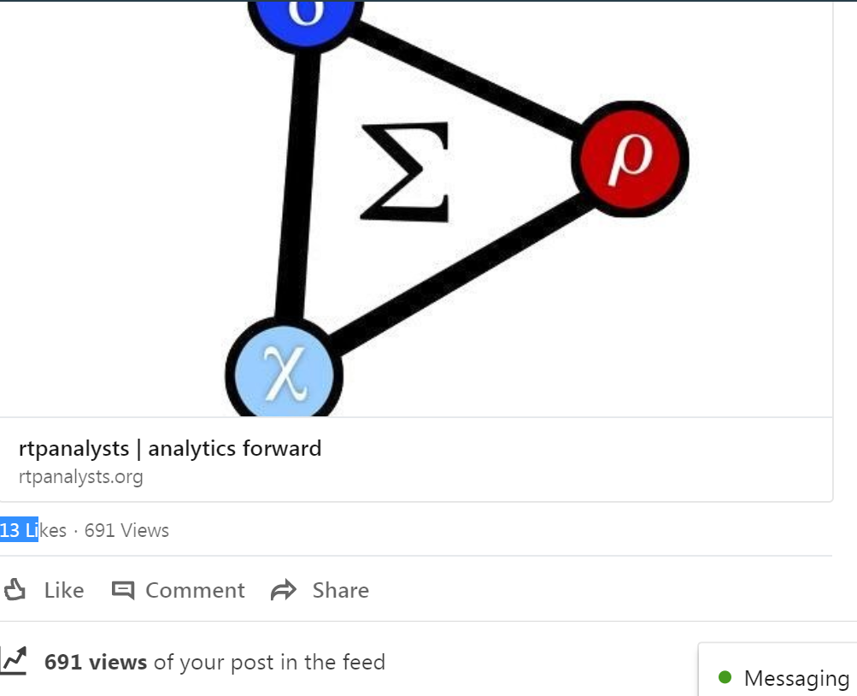

Slide 50
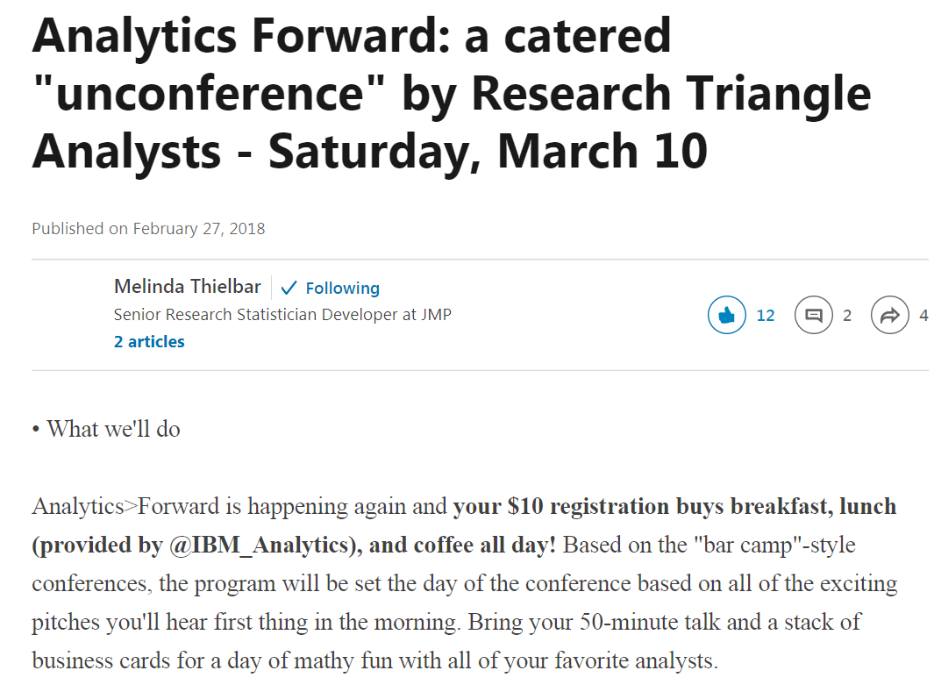

Slide 51
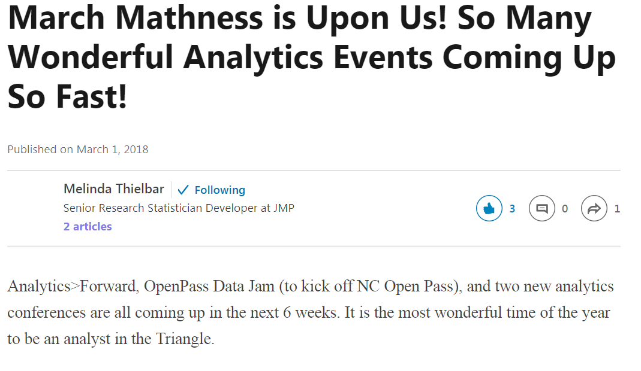

Slide 52
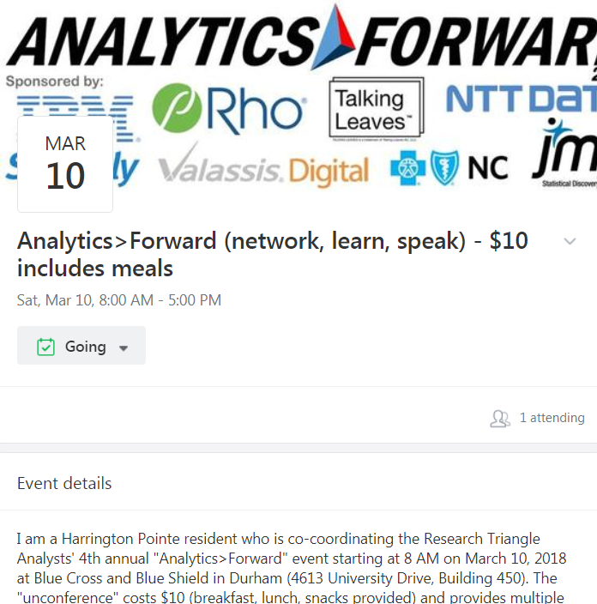

Slide 53
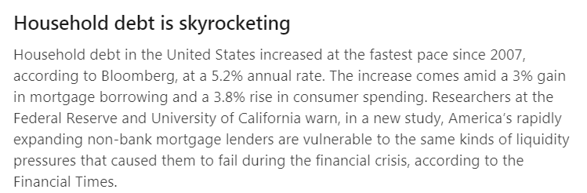

Slide 54
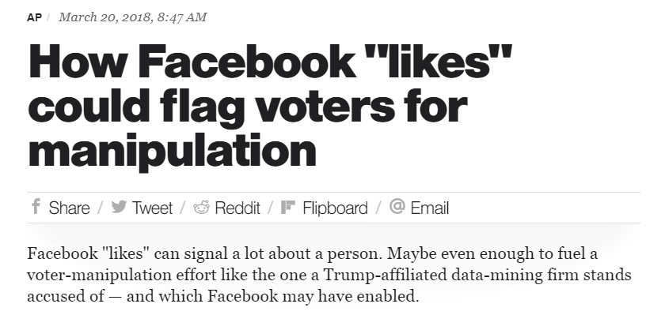
Cambridge Analytica

Slide 55
Rick Pack – rickeyhp@gmail.com
Show my Fbadstats R package (only has FBadGstats function) and invite you to explore $30k of ads performance data
Encourage the perception of online marketing as gambling and addictive to data geeks
Encourage healthy use of social media

